Slide 1
Writing Complex Equations with LMS Equation Editor
DR. O.O. DARAMOLA

Slide 2
Some complex equations
Tex command

Slide 3
How it appear

Slide 4
Less/Greater or equal to (Tex command)

Slide 5
It appears as

Slide 6
The code for matrix in TeX command

Slide 7
The Tex command can be directly write on Page content provided as
$$ M = \left[\begin{array}{ccc} 1&2&3 \\ 4&5&6 \\ 7&8&9\end{array}\right] $$
And press save to continue bottom after enable all necessary (enter)
It then appears as shown

Slide 8
It Appears as

Slide 9
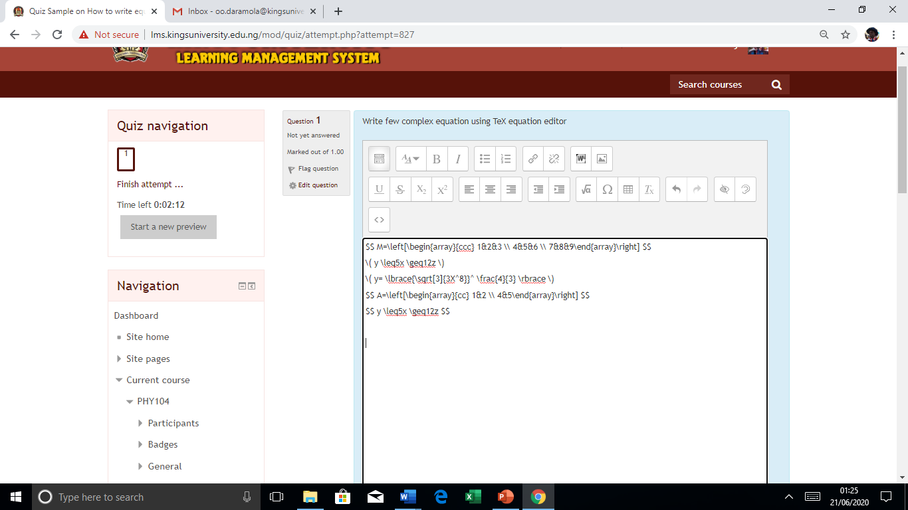
Using in Examination/test on LMS
It appear as shown below when not yet press summit bottom

Slide 10
After submit, it appear as shown below

Slide 11
Starting and ending code difference
$$ $$ This is to put final equation as centre (formatting)
\( \) This is not to centralized the equation (formatting)

Slide 12
Thank you for listening
DR. O. O DARAMOLA

